Slide 1
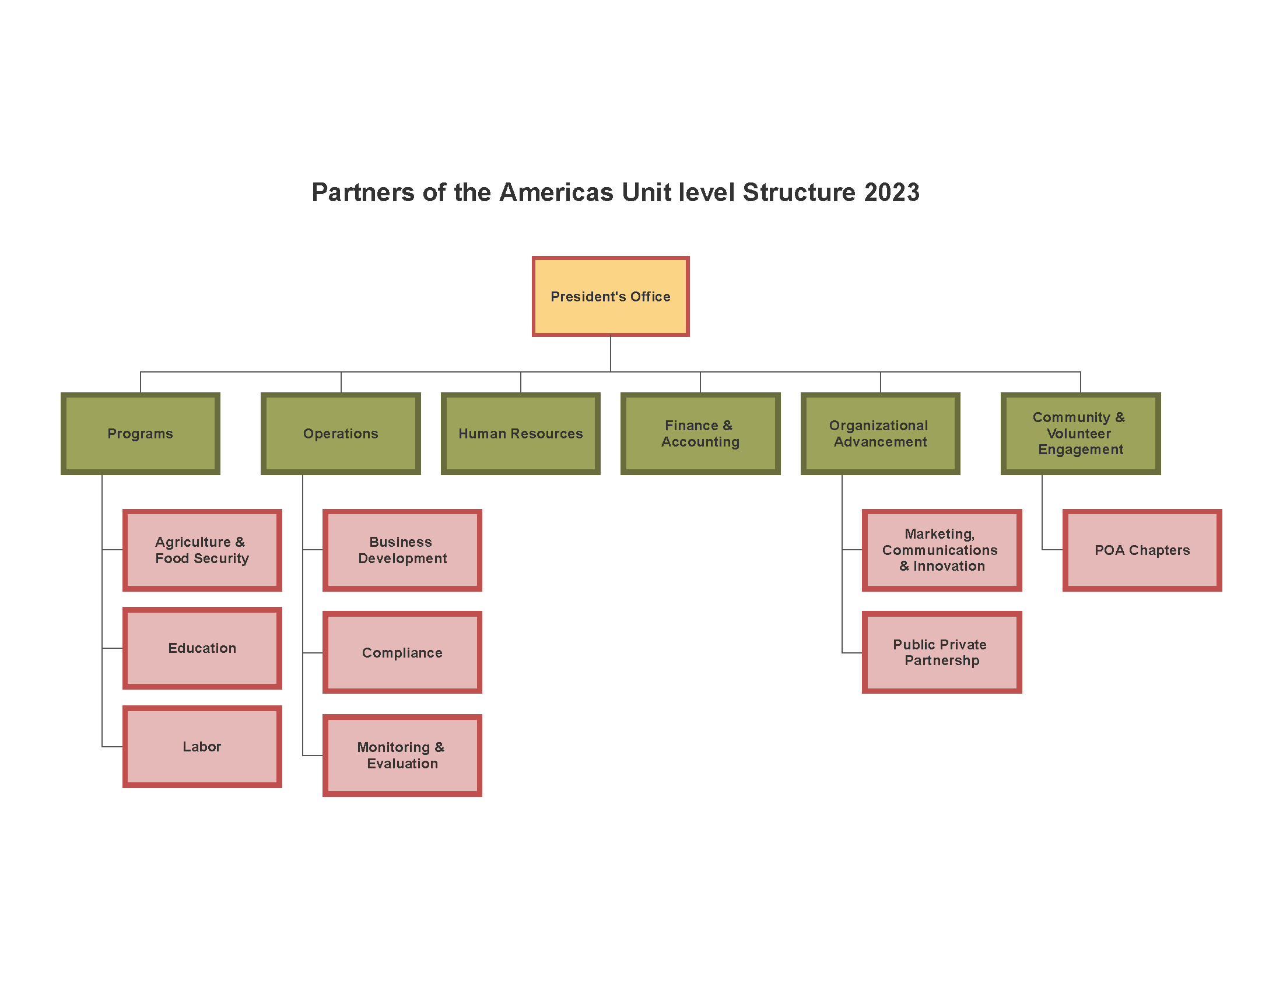



Partners of the Americas │ 2024
www.partners.net | @PartnersAmerica | /PartnersAmericas
Notes:
Big picture: Four main organizational Divisions; under each division, we have multiple Units
Programs: All programs will report up to the Sr. VP of Programs
Operations: All aspects of operations will feed into the COO – HR, Compliance, IT, Membership
Finance: Self-explanatory; with our growth, this unit needs to focus on building our Financial capacity here and in field offices; all Admin-related activities will fall under Operations
Organizational Advancement: New unit focused on expanding our capacity to bring in resources, both public and private, restricted and unrestricted; this unit will house Business Development, Marketing & Communications, Public-Private Partnerships and eventually a growing philanthropy team

Slide 2
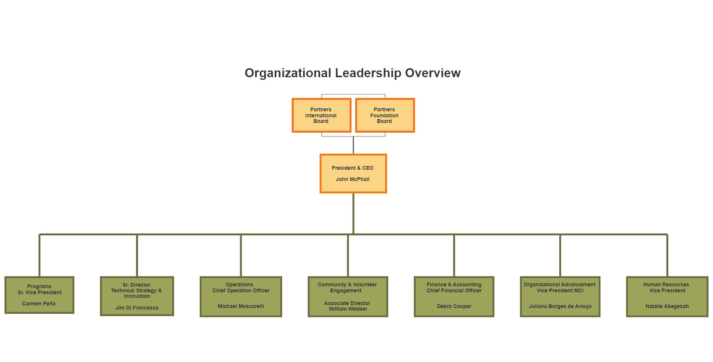
Partners of the Americas │ 2024
www.partners.net | @PartnersAmerica | /PartnersAmericas
Notes:
Big picture: Four main organizational Divisions; under each division, we have multiple Units
Programs: All programs will report up to the Sr. VP of Programs
Operations: All aspects of operations will feed into the COO – HR, Compliance, IT, Membership
Finance: Self-explanatory; with our growth, this unit needs to focus on building our Financial capacity here and in field offices; all Admin-related activities will fall under Operations
Organizational Advancement: New unit focused on expanding our capacity to bring in resources, both public and private, restricted and unrestricted; this unit will house Business Development, Marketing & Communications, Public-Private Partnerships and eventually a growing philanthropy team

Slide 3
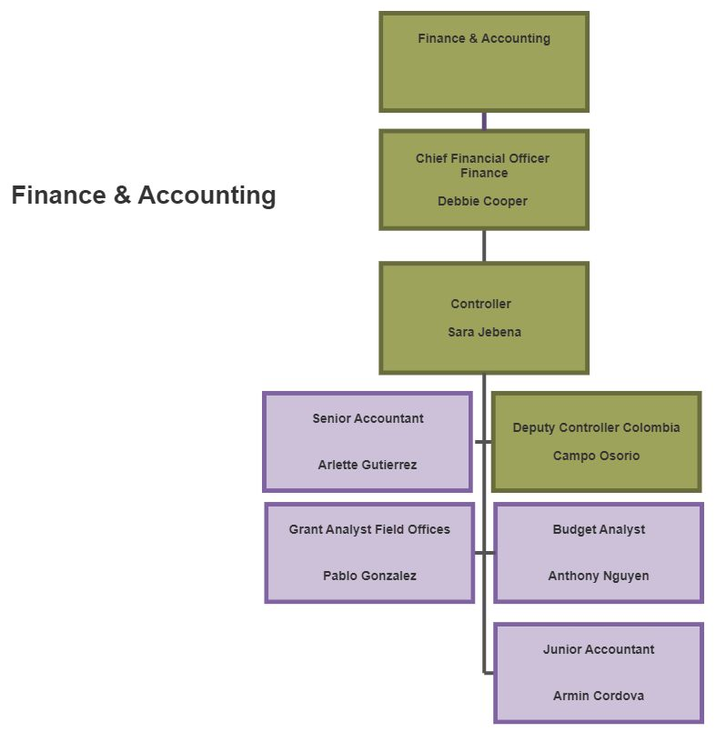
Partners of the Americas │ 2024
www.partners.net | @PartnersAmerica | /PartnersAmericas
Notes:
Peggy is looking to move to a part-time role; as a result, she will take on an advisory role and special projects
A new Controller will therefore be starting soon

Slide 4
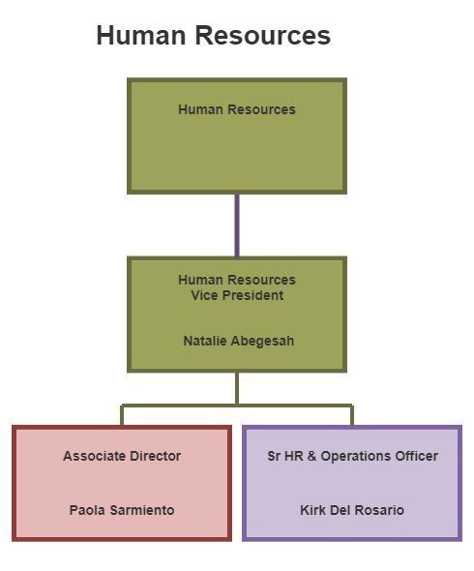
Partners of the Americas │ 2024
www.partners.net | @PartnersAmerica | /PartnersAmericas
Notes:
Peggy is looking to move to a part-time role; as a result, she will take on an advisory role and special projects
A new Controller will therefore be starting soon

Slide 5
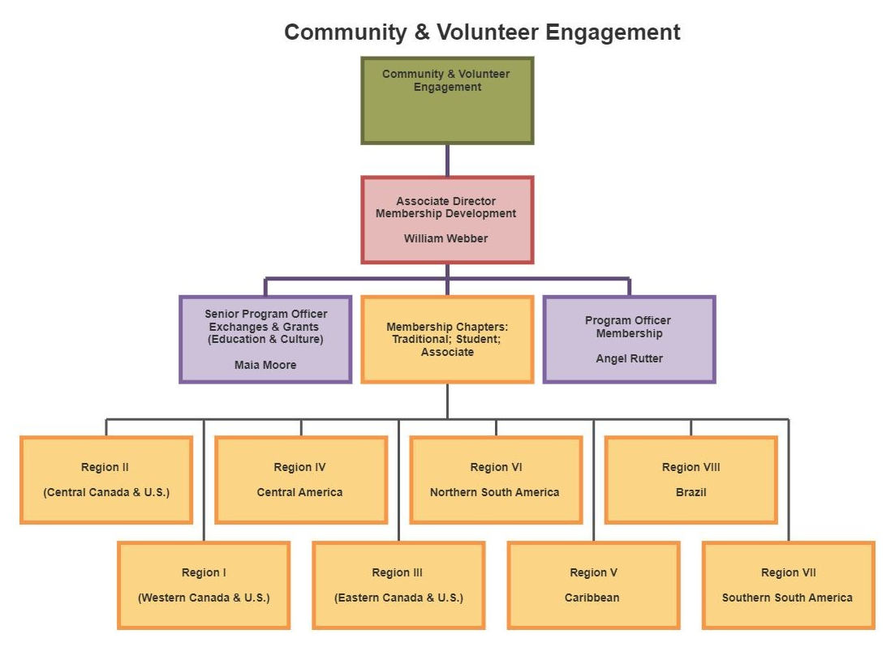
Partners of the Americas │ 2024
www.partners.net | @PartnersAmerica | /PartnersAmericas
Notes:
Peggy is looking to move to a part-time role; as a result, she will take on an advisory role and special projects
A new Controller will therefore be starting soon

Slide 6
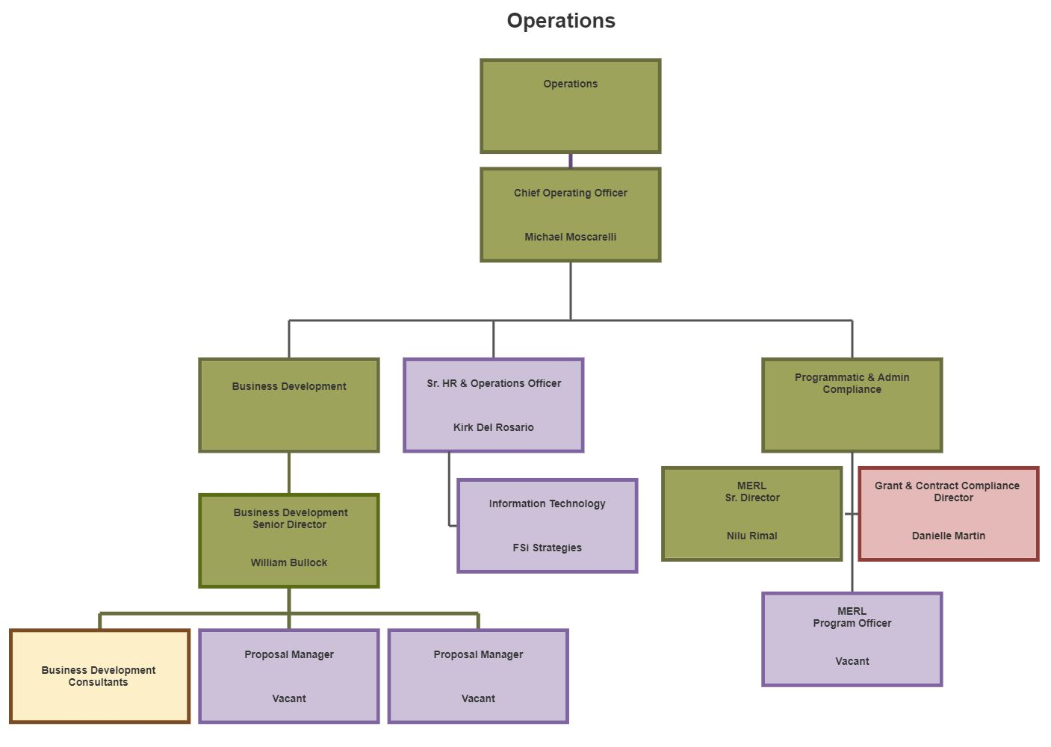
Partners of the Americas │ 2024
Notes:
A lot happening here!
HR will continue to be an important focus, led by Natalie and her team, for both HO and field offices
New focus on compliance – we have a new Sr Director of MERL, Nilu Rimal
Have incorporated our Grant and Contract Compliance under this unit as well
Membership will now be part of a larger unit called “Community and Volunteer Engagement”
This unit is placed here because most of our efforts with the chapters is mostly focused on operations
Some of the work is programmatic in nature, so it’s not a completely smooth distinction, but E&C provides significant benefits to the chapters
Operations Officer – vacant
Information Technology also will be coordinated by the Operations Division

Slide 7
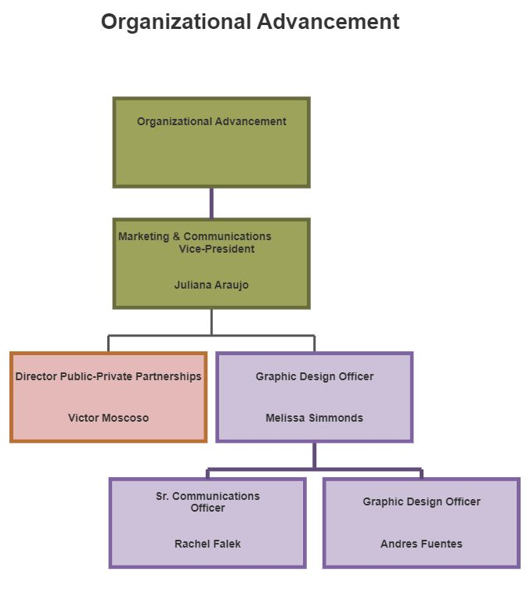
Partners of the Americas │ 2024
www.partners.net | @PartnersAmerica | /PartnersAmericas
Notes:
Organizational Advancement: New unit focused on expanding our capacity to bring in resources, both public and private, restricted and unrestricted; this unit will house Business Development, Marketing & Communications, Public-Private Partnerships and eventually a growing philanthropy team
Unit will be led by Wayne Johnson, a seasoned individual with both public and private sector experience; he is very entrepreneurial in nature and will be leading our lobbying efforts with the USG as well as working to open doors at a high level in the government, corporate sector, and foundations.
Will also lead the growth of the unit towards more fundraising with individual giving, major gifts, events, estate planning, on-line campaigns and giving; this will be a multi-year process; we can only focus on so much for now!
This is also why we have Marketing and Communications, which will be led by Juliana, and Public-Private Partnerships, led by Ukiah, in this unit. The teams will work together on proposal development and unrestricted fundraising efforts.
Summar will also support the unit while she finalizes work on two programs – BAP and META – focusing on the YES strategy and working with the team to innovate / incubate new ideas.
The unit will explore initiatives, such as Exchange programs, EQUAL Americas, A Ganar, YouthLead.
Program Development will continue under Marcio with his growing team. We have on vacant function regarding budget and pricing;
In addition, we are looking to promote greater levels of innovation, led by this unit where we will look to incubate new ideas; once these become viable projects, they will then be transferred to the appropriate Division

Slide 8
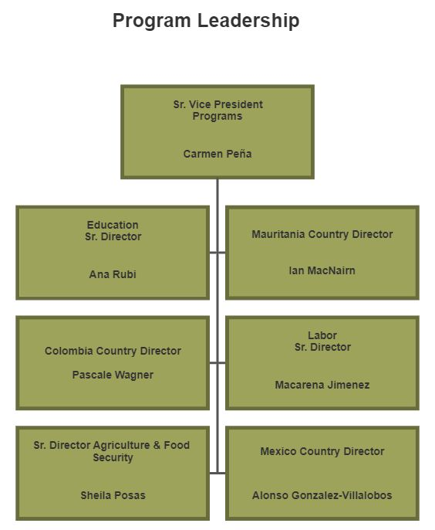
Partners of the Americas │ 2024
www.partners.net | @PartnersAmerica | /PartnersAmericas
Notes:
Here is a major change in how we define our programs.
Carmen will oversee this unit and have four direct reports
As you can see, we’ve change the units; no longer do we have EDH, EGC and CPU.
CPU becomes Labor and Education
EDH becomes AFS
EGC is folded into Education and a part of it is under our Operations Division in the Community and Volunteer Engagement Unit
It is important to note that this structure will require that we empower our units more. The Unit Directors will be leading the programs and be empowered to make decisions on these programs while the Sr VP oversees all of this and provides appropriate support to help the units be successful, and to also represent the organization more externally and help on organizational advancement.
Unit Directors and Home Office team members will also need to transition from directly managing field programs to providing technical support and compliance oversight.
Fundamental change – becoming more technical experts and managing programs in a matrix-style of management (without direct supervisory oversight)

Slide 9
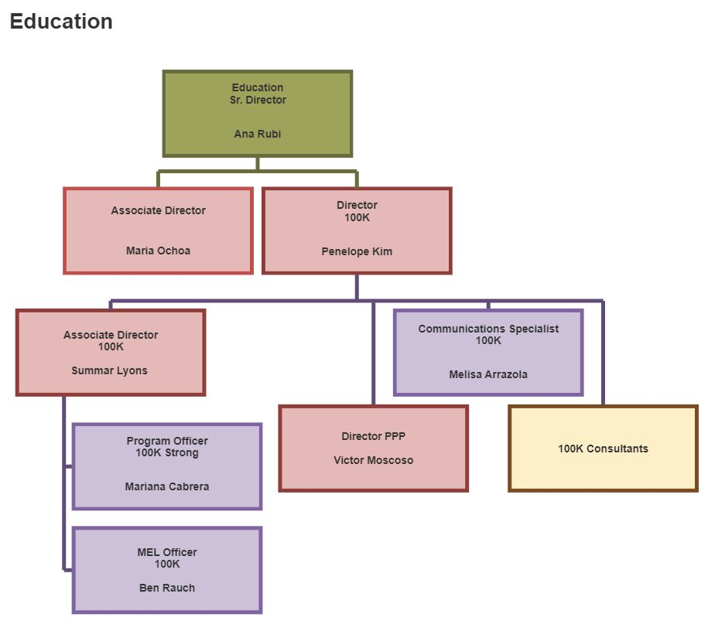
Partners of the Americas │ 2024
www.partners.net | @PartnersAmerica | /PartnersAmericas
Notes:
The Education Unit will be led by Ana Rubi and in addition to the HUGE JA program, we will now have the 100K program here. All future education initiatives will be managed under this unit.

Slide 10
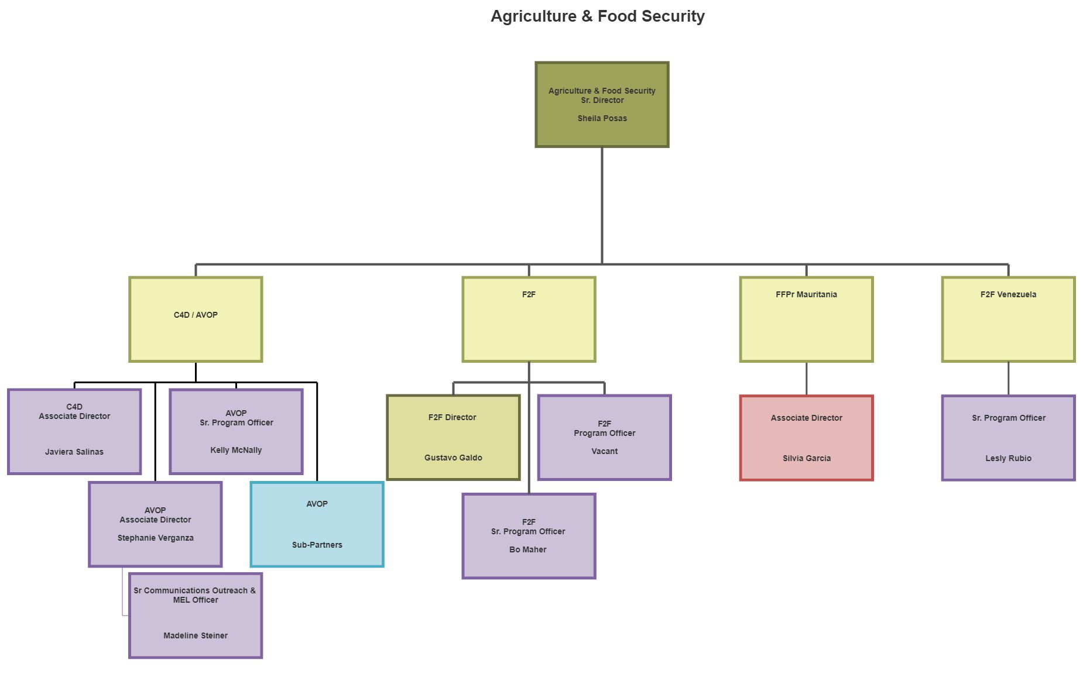
Partners of the Americas │ 2024
www.partners.net | @PartnersAmerica | /PartnersAmericas
Notes:
Organizational Advancement: New unit focused on expanding our capacity to bring in resources, both public and private, restricted and unrestricted; this unit will house Business Development, Marketing & Communications, Public-Private Partnerships and eventually a growing philanthropy team
Unit will be led by Wayne Johnson, a seasoned individual with both public and private sector experience; he is very entrepreneurial in nature and will be leading our lobbying efforts with the USG as well as working to open doors at a high level in the government, corporate sector, and foundations.
Will also lead the growth of the unit towards more fundraising with individual giving, major gifts, events, estate planning, on-line campaigns and giving; this will be a multi-year process; we can only focus on so much for now!
This is also why we have Marketing and Communications, which will be led by Juliana, and Public-Private Partnerships, led by Ukiah, in this unit. The teams will work together on proposal development and unrestricted fundraising efforts.
Summar will also support the unit while she finalizes work on two programs – BAP and META – focusing on the YES strategy and working with the team to innovate / incubate new ideas.
The unit will explore initiatives, such as Exchange programs, EQUAL Americas, A Ganar, YouthLead.
Program Development will continue under Marcio with his growing team. We have on vacant function regarding budget and pricing;
In addition, we are looking to promote greater levels of innovation, led by this unit where we will look to incubate new ideas; once these become viable projects, they will then be transferred to the appropriate Division

Slide 11
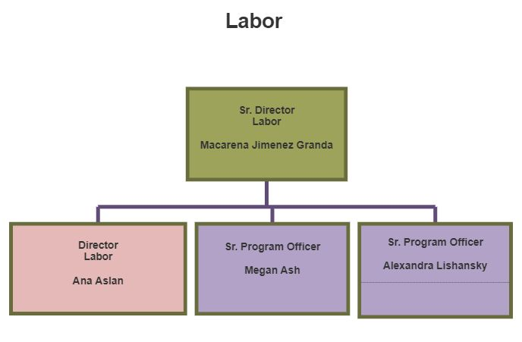
Partners of the Americas │ 2024
www.partners.net | @PartnersAmerica | /PartnersAmericas
Notes:
The Education Unit will be led by Ana Rubi and in addition to the HUGE JA program, we will now have the 100K program here. All future education initiatives will be managed under this unit.

Slide 12
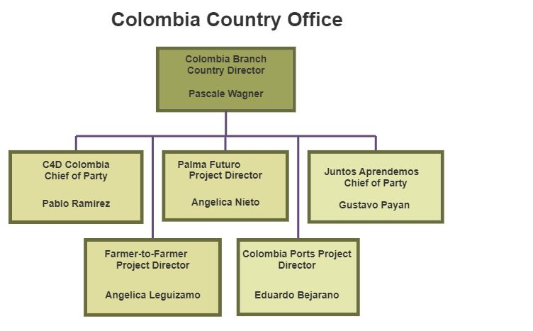
Partners of the Americas │ 2024
www.partners.net | @PartnersAmerica | /PartnersAmericas
Notes:
As Country Director, Sara will supervise all project directors directly. They will no longer report to Home Office staff.
Technical support and guidance should still come from our HO teams; however, the PDs need to be empowered to manage their programs and be accountable to the results.
This is a major shift in how we operate which will require us to look closely at how we do our work.
The COO will guide a process of reviewing our roles and responsibilities to make this shift work, as smoothly as possible, and with the support of the teams.
In addition, in Colombia, we have been discussing with Sara about how to align the in-country structure more with how we operate in the HO. Sara will work with the team to define what that looks like; however, in the next few months, they will be discussing how to maximize the administrative, financial and operational resources under one Country Office, versus SIX separate projects.

Slide 13
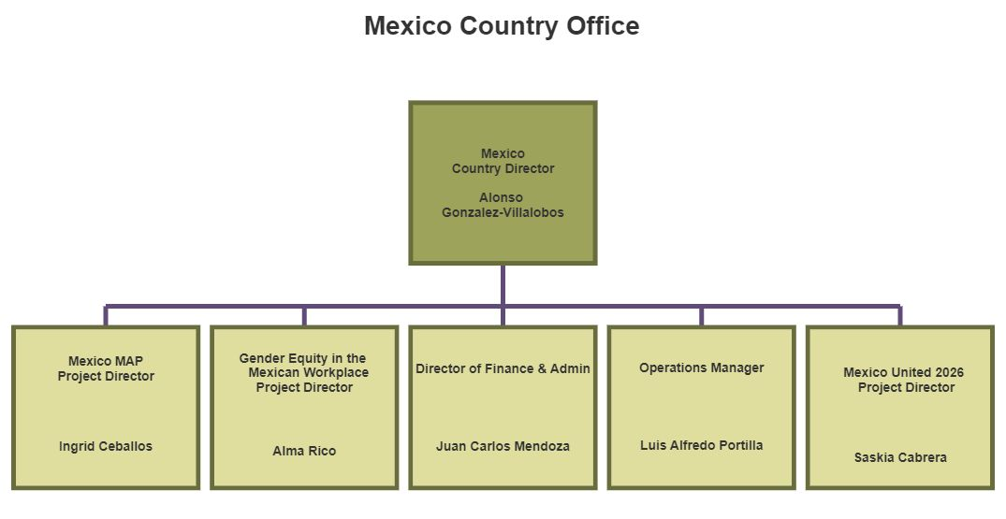
Partners of the Americas │ 2024
www.partners.net | @PartnersAmerica | /PartnersAmericas
Notes:
As Country Director, Sara will supervise all project directors directly. They will no longer report to Home Office staff.
Technical support and guidance should still come from our HO teams; however, the PDs need to be empowered to manage their programs and be accountable to the results.
This is a major shift in how we operate which will require us to look closely at how we do our work.
The COO will guide a process of reviewing our roles and responsibilities to make this shift work, as smoothly as possible, and with the support of the teams.
In addition, in Colombia, we have been discussing with Sara about how to align the in-country structure more with how we operate in the HO. Sara will work with the team to define what that looks like; however, in the next few months, they will be discussing how to maximize the administrative, financial and operational resources under one Country Office, versus SIX separate projects.

Slide 14
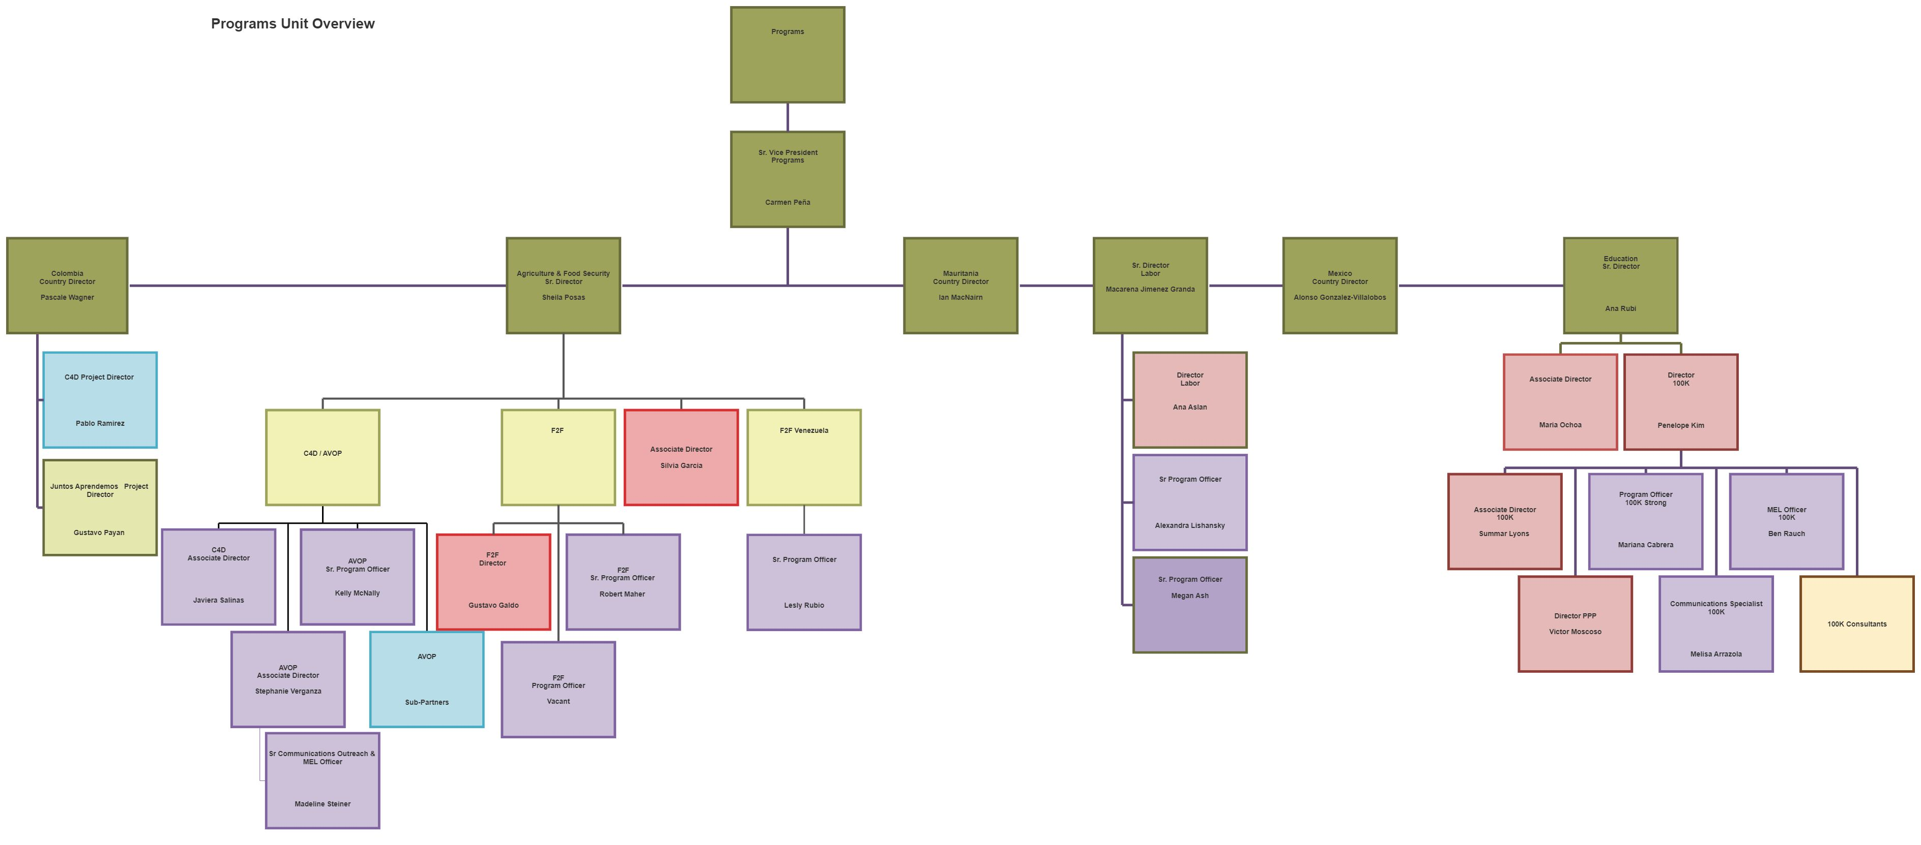
Partners of the Americas │ 2024
www.partners.net | @PartnersAmerica | /PartnersAmericas
Notes:
Organizational Advancement: New unit focused on expanding our capacity to bring in resources, both public and private, restricted and unrestricted; this unit will house Business Development, Marketing & Communications, Public-Private Partnerships and eventually a growing philanthropy team
Unit will be led by Wayne Johnson, a seasoned individual with both public and private sector experience; he is very entrepreneurial in nature and will be leading our lobbying efforts with the USG as well as working to open doors at a high level in the government, corporate sector, and foundations.
Will also lead the growth of the unit towards more fundraising with individual giving, major gifts, events, estate planning, on-line campaigns and giving; this will be a multi-year process; we can only focus on so much for now!
This is also why we have Marketing and Communications, which will be led by Juliana, and Public-Private Partnerships, led by Ukiah, in this unit. The teams will work together on proposal development and unrestricted fundraising efforts.
Summar will also support the unit while she finalizes work on two programs – BAP and META – focusing on the YES strategy and working with the team to innovate / incubate new ideas.
The unit will explore initiatives, such as Exchange programs, EQUAL Americas, A Ganar, YouthLead.
Program Development will continue under Marcio with his growing team. We have on vacant function regarding budget and pricing;
In addition, we are looking to promote greater levels of innovation, led by this unit where we will look to incubate new ideas; once these become viable projects, they will then be transferred to the appropriate Division

